Slide 1




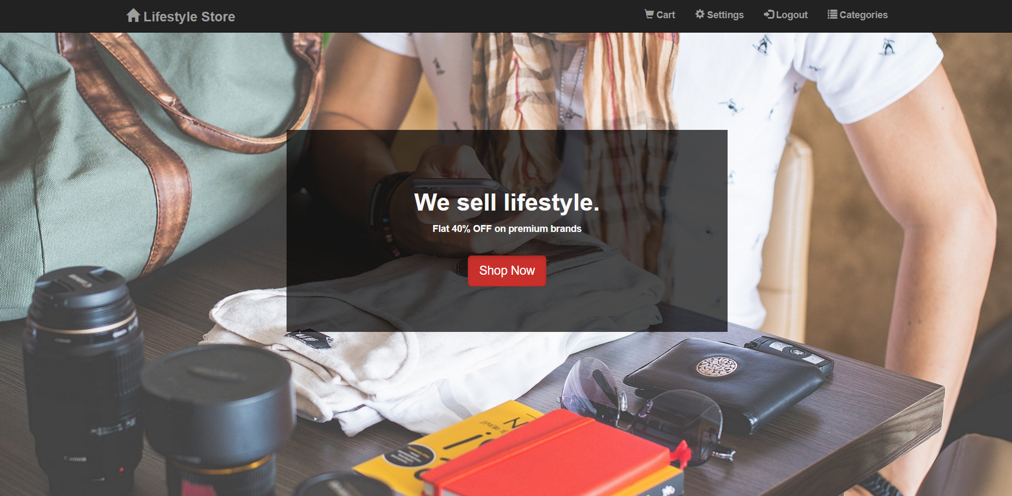
Ecommerce Shopping Cart
Techno India NJR Institute of technology
Computer Science and Engineering
4th year
SUBMITTED BY-
CHARUL MEHTA (18ETCCS023)
SURBHI SINGH (18ECTCCS086)
JINAL BHARDWAJ (19ETCCS203)

Slide 2
Content-
Abstract
Components and Modules
Methodology
Project Dependency
Scope

Slide 3
Abstract-
● The idea behind this shopping cart is to make it more easy and effective for the customers to see and select products online from homes, offices, etc.
● This Ecommerce shopping cart enables consumers to select products, review what they have selected, make modifications, or add extra items if needed, and purchase the products.
● The website will include various things for a customer, for example, we will include: 4 sections of Men, Women, Kids and Accessories.
● Add to cart is also an option so a customer can easily add things to the cart and if they don’t want to buy at present they can later buy it from add to cart.
● And Proceed to Pay option will be also available.

Slide 4

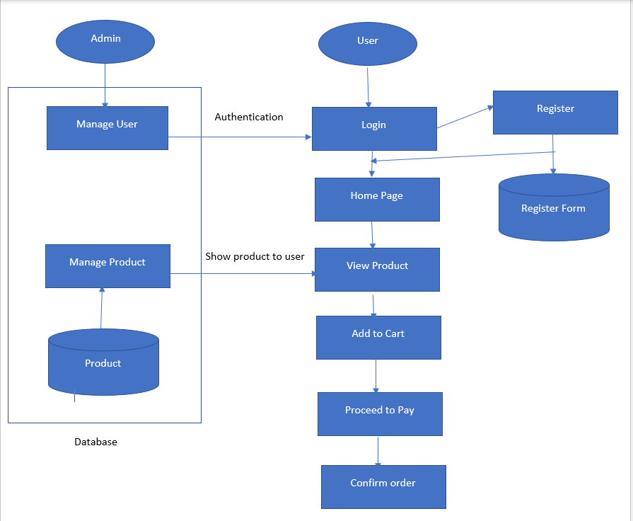
User login/register
If user is registering ,the register form will appear else direct login through login and password.
User explore the home page product and content .
User go through product specifications , quality and description.
User add product into the cart .
User can proceed to pay.
Order confirmation popup appeared .
Admin manages the product order and requirement .
Admin de the product and send tracking details to user portal.

Slide 5
Dashboard-

Slide 6
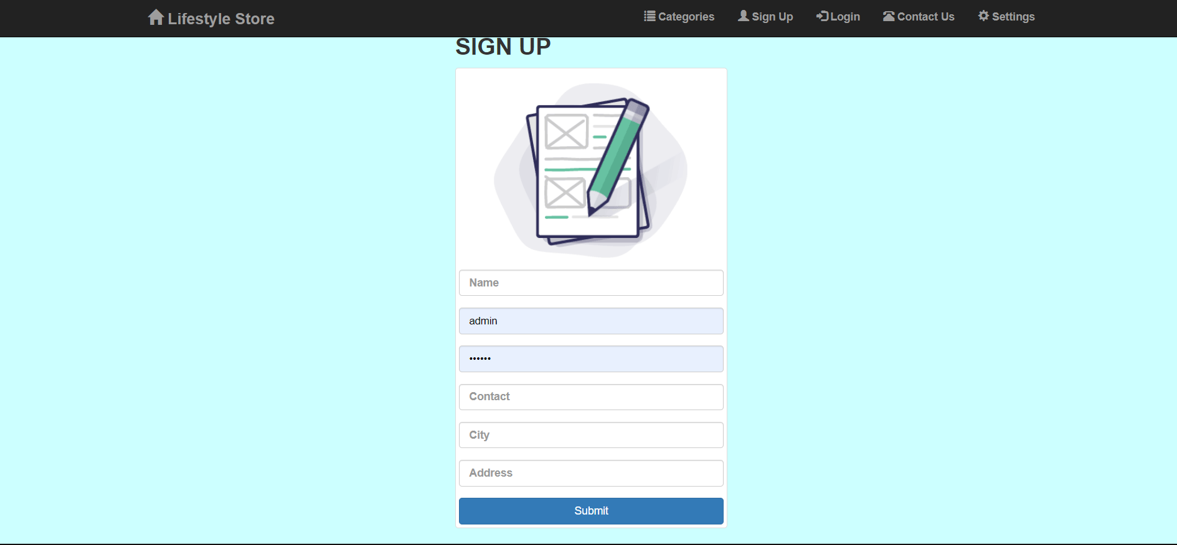
Sign up Page-

Slide 7
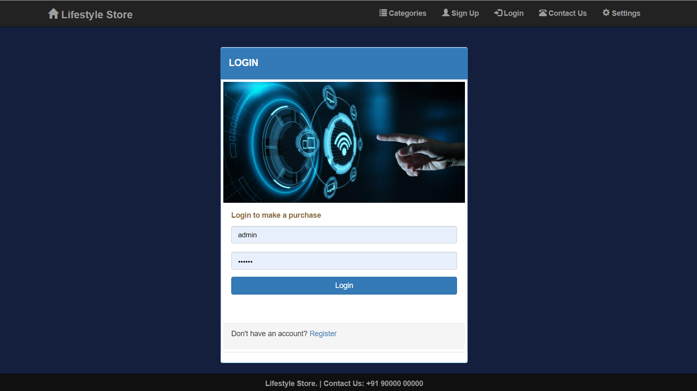
Log in Page-

Slide 8
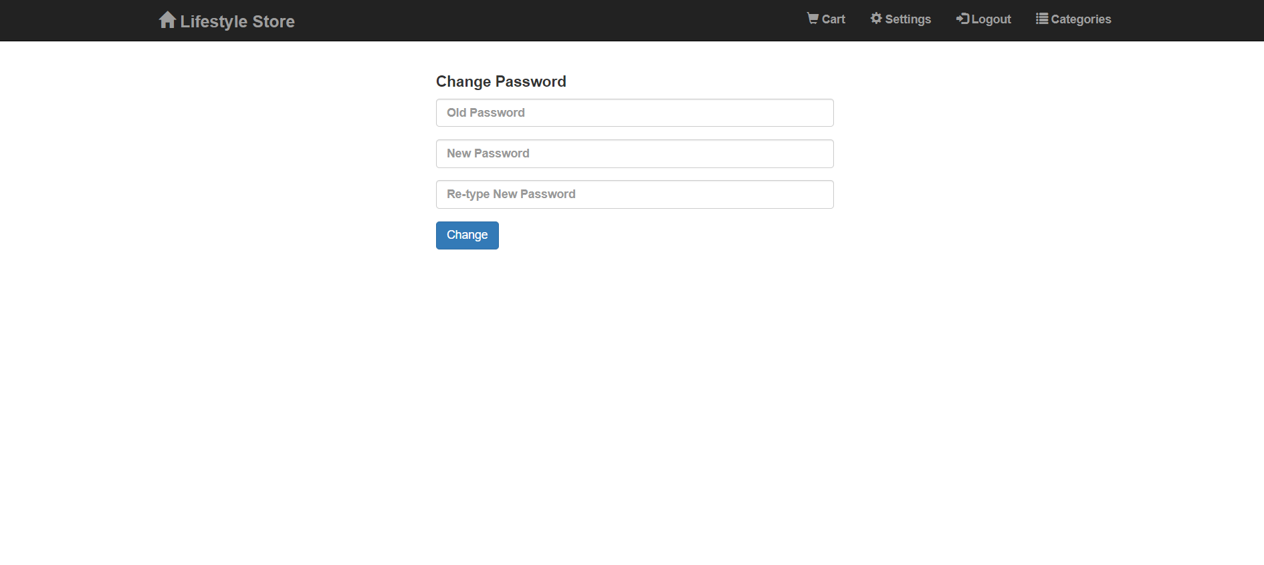
Settings-

Slide 9
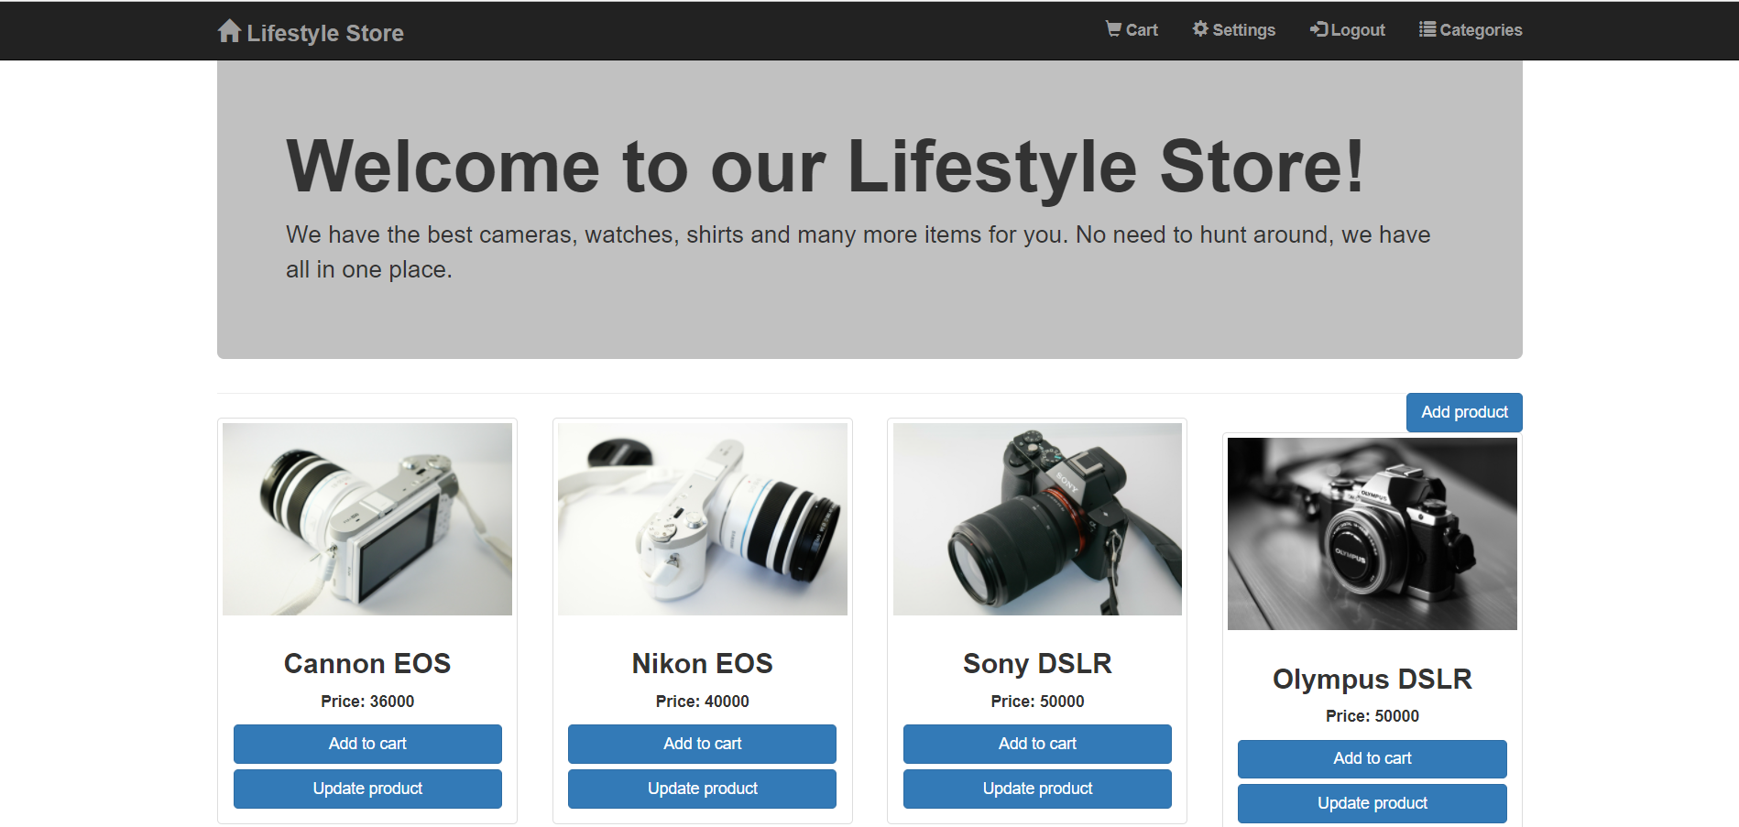
What admin can do?

Slide 10
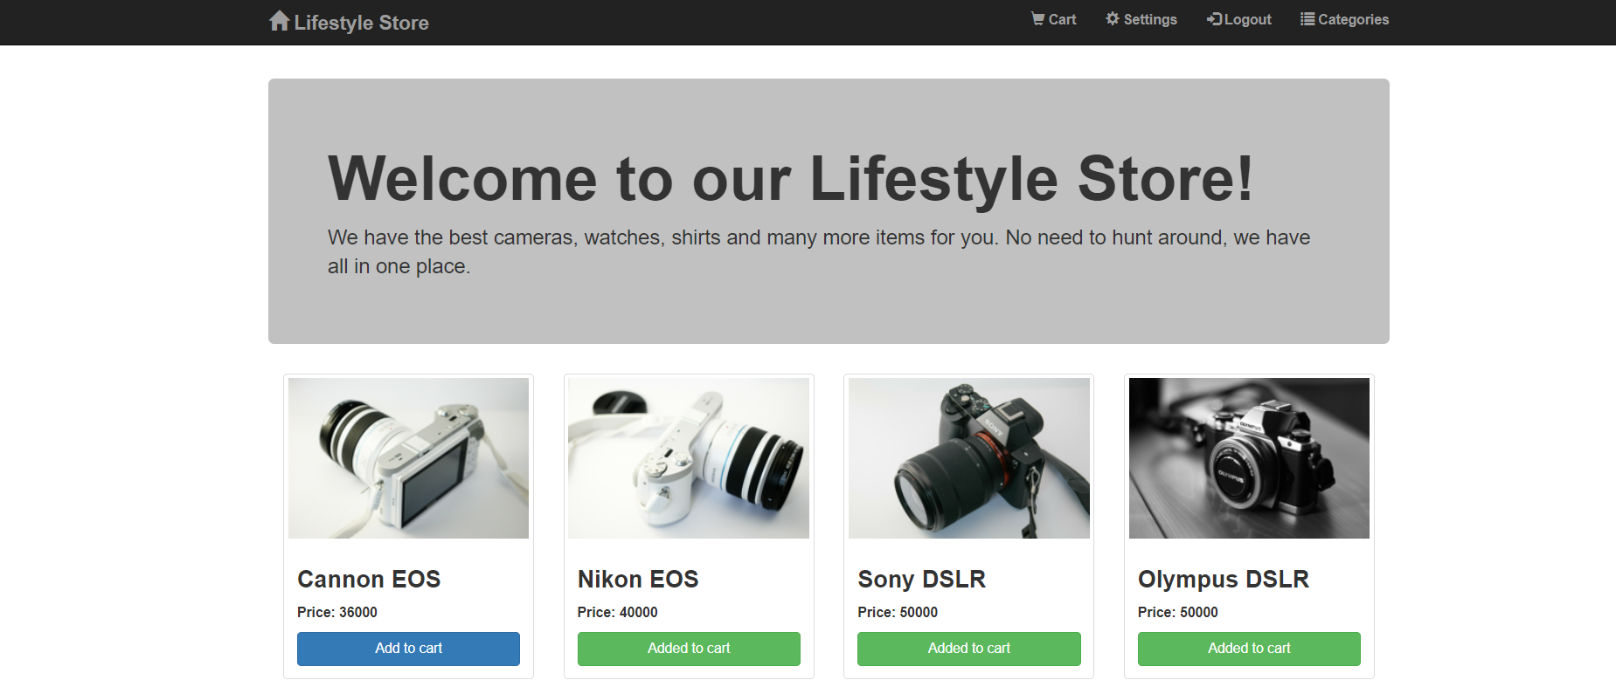
Product Page

Slide 11
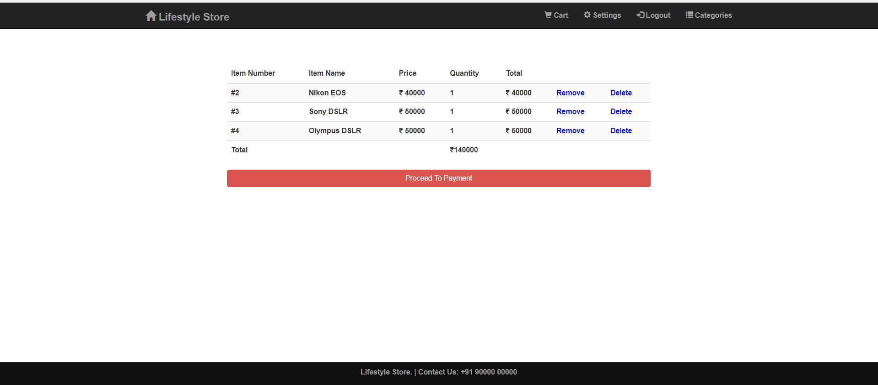
Cart Page

Slide 12
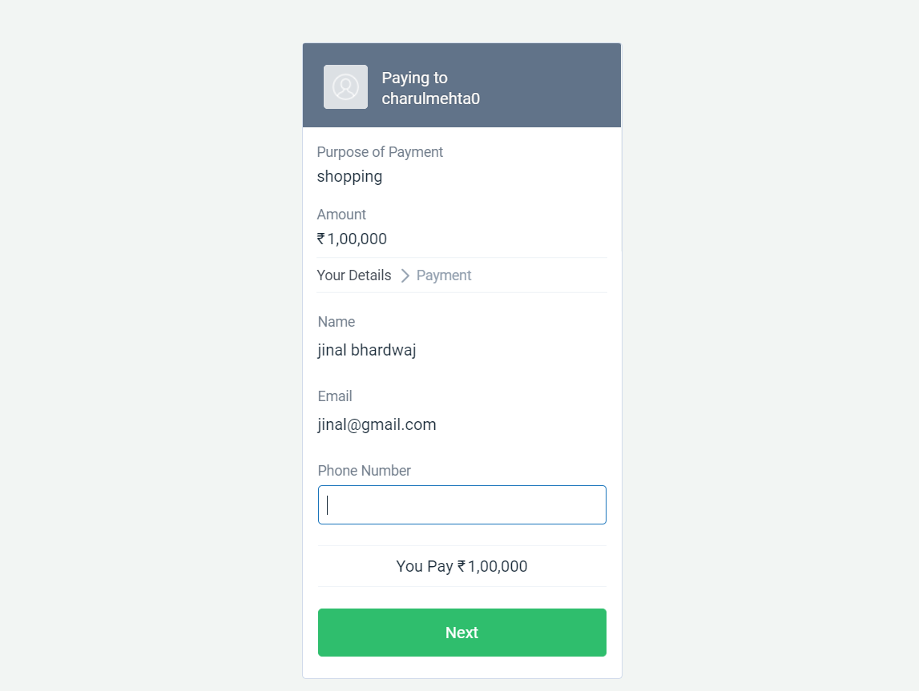
Payment Page

Slide 13
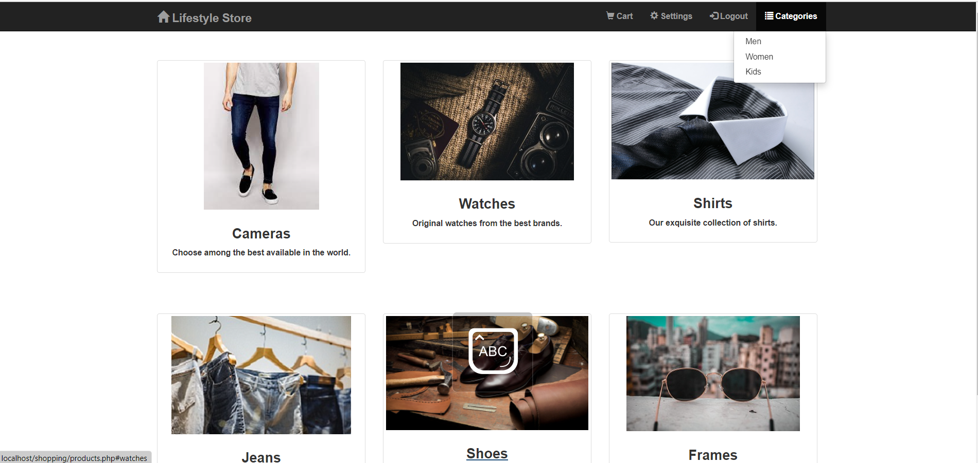
Men’s Category

Slide 14
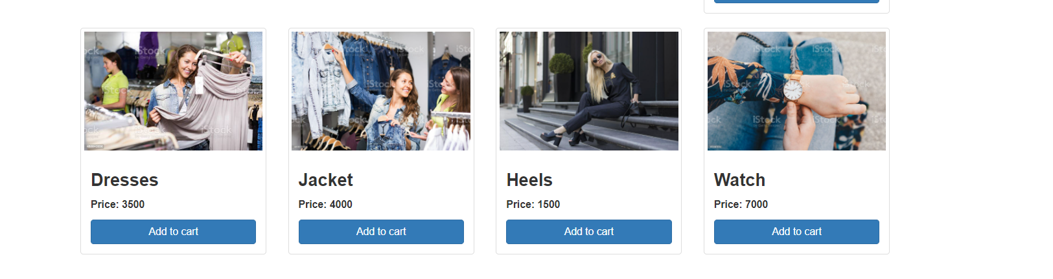
Women Category

Slide 15
Project dependency-
FRONT END
HTML
CSS
JS (JavaScript)
Bootstrap
jQuery
SERVER END (BACKEND)
PHP.
MySQL
XAMPP
SOFTWARE USED
Visual studio Code

Slide 16
Scope-
This project covers the online selling of fashion accessories, watches, cameras etc. The project shows the product category and then product details. From the product details, the product can be added to cart and can be bought.

Slide 17
Thank you

